Slide 1
Kansas City Neighborhood Health Index Analysis
Braeden Vaughn, Harrison Terry, Caston Stack and Alex Schaeffer
3/16/2021

Slide 2

Overview
Our Team
Introduction
Objectives & Methods
Principal Component Analysis (PCA)
Findings
Concluding Remarks

Slide 3
Group 2
Braeden
Harrison
Caston
Alex
Team Lead: Revisions, Analysis, prepared slides
Mathematics Major
Mechanical Engineering and Math Major
Project Manager, prepared slides, presenter
MS Statistics
Senior Mathematics Undergrad

Slide 4
Introduction

Slide 5
Introduction
To study social health inequalities, we will look at multiple dimensions of neighborhood data to summarize and further analyze socioeconomic status.
These kinds of datasets are beneficial to summarize as they can provide insight into what truly is important to a given neighborhood.
These socioeconomic status analyses are shown to be strong predictors of many health problems such as mental illness or malnutrition

Slide 6
Objectives & Method
The first dataset that we are using for this analysis is a dataset of 200 Kansas City, Missouri (KCMO) neighborhoods, looking at 17 specific variables including crime occurrences, education levels of the neighborhood, and more.
To obtain a meaningful results, we will first run Principal Component Analysis (PCA) on the data to reduce the number of variables.
The second dataset will consist of the first dataset in addition to the average time to complete 311 services in the respective neighborhoods
This allows us to simplify the model into interpretable pieces. From these relevant variables, we will rank the KCMO neighborhoods.

Slide 7
Principal Component Analysis (PCA)
PCA is a process where the dimension of the initial dataset is reduced. The goal is to reduce the number of variables being analyzed at any given time while still obtaining as much information as possible.
Datasets with large numbers of variables include information that not necessarily relevant to analysis. The resulting dispersion matrix while including all the data is often too large to study and/or yield meaningful interpretations. For example, in a factorial design of size N, adding an additional variable to analyze increases the number of pairwise combinations by N+1, greatly increasing the complexity as the number of variables being analyzed increases.
The PCA process utilizes the singular value decomposition on the covariance or correlation matrix of out data matrix X. on being able calculate eigenvalues of these large NxN matrices. From this decomposition we will have the eigen-vectors (which will be our new principal components

Slide 8

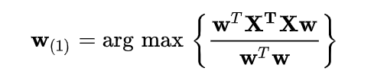
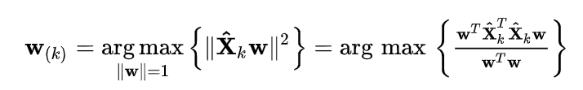
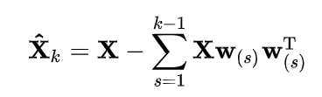
Principal Component Analysis (PCA)
To identify the relevant variables we must compute the covariance matrix and the eigenvalues from our original dataset.
From our eigenvalues, we order the individual eigenvalues from largest to smallest along the diagonal of an NxN matrix.
The first principal component satisfies the equation:
Each subsequent principal component can be found by:
given
By these definitions, the first PC will have the largest variance that is contributed to the model and each subsequent PC will have less.
This is an example of a 3x3 covariance matrix. Note that Cov(x,x) = Var(x).

Slide 9
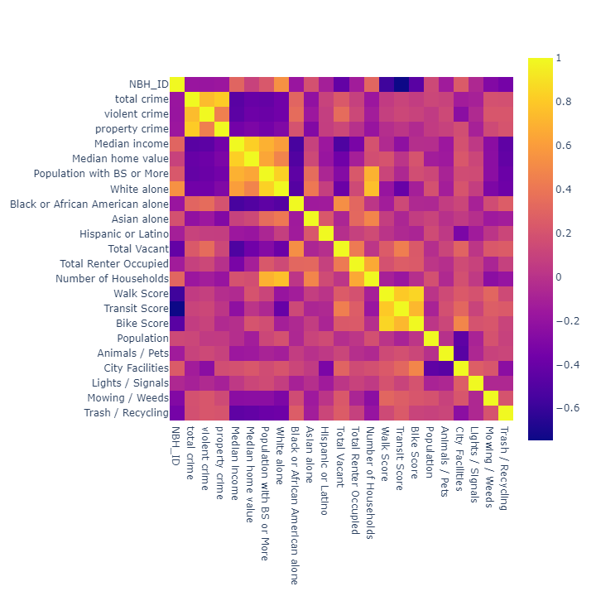
Our Variables: A Study
To the right is a heatmap of our (symmetric) correlation matrix. A few correlations to note:
I. Expectedly, total, violent, and property crime correlate strongly.
A. Total Crime vs. Violet Crime: 0.742
B. Total Crime vs. Property Crime: 0.811
II. Medium home value and medium income correlate strongly (0.825)
III. Walk Score is over 80% correlated with both transit and biking. We can regard these as general indicators of mobility.
A. Walk Score vs. Transit Score: 0.803
B. Walk Score vs. Bike Score: 0.852
C. Bike Score vs. Transit Score: 0.726
IV. The variables White Alone and Population with BS or More share a 0.836 linear correlation.
Since Corr(X) is symmetric, it’s also orthogonally diagonalizable.

Slide 10
PCA: First Run
Communalities
 | Initial | Extraction
total crime | 1.000 | 0.472
violent crime | 1.000 | 0.423
property crime | 1.000 | 0.338
Median income | 1.000 | 0.691
Median home value | 1.000 | 0.570
Population with BS or More | 1.000 | 0.807
White alone | 1.000 | 0.698
Black or African American alone | 1.000 | 0.396
Asian alone | 1.000 | 0.230
Hispanic or Latino | 1.000 | 0.001
Total Vacant | 1.000 | 0.504
Total Renter Occupied | 1.000 | 0.346
Number of Households | 1.000 | 0.331
Walk Score | 1.000 | 0.718
Transit Score | 1.000 | 0.740
Bike Score | 1.000 | 0.729
Population | 1.000 | 0.003
Extraction Method: Principal Component Analysis.
The Extraction Communalities table describes the proportion of each variable’s variance that can be explained by the principal components.
Note here that both the variables “Hispanic or Latino” and “Population” both have low values in the extraction column. This tells us that these variables are not being represented in these first two components. In the future we could run the analysis again without these factors and analyze those results.

Slide 11
Explaining the Metrics:
We want to be sure that our data is well fit for PCA. The following two outputs tell us that:
KMO measures how much of our variance might be caused by underlying factors. The closer to 1 the better. By rerunning with some changes to our data we could improve our KMO score
Bartlett’s Test of Sphericity tests the hypothesis that our correlation matrix is the identity matrix. Hence our data being uncorrelated. In this case the value is sufficiently low enough to reject this hypothesis.
KMO and Bartlett's Test
Kaiser-Meyer-Olkin Measure of Sampling Adequacy. |  | 0.680
Bartlett's Test of Sphericity | Approx. Chi-Square | 2860.729
 | df | 136
 | Sig. | 0.000

Slide 12
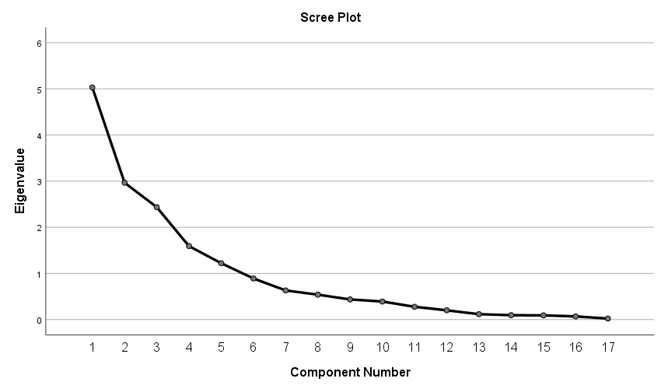
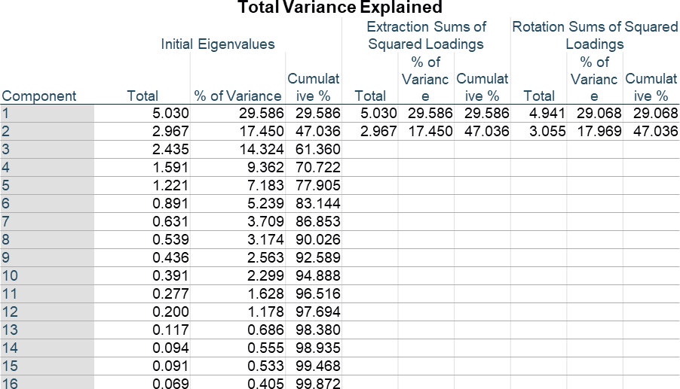
Principal Component Analysis (PCA)
We can use the above scree plot to help decide how many principal components (eigenvectors) to include. We’re looking for when the slope level off, so to speak.
The higher the percent explained, the better; but at some point, it may not be worth it to add more components. In this case the first two components explain 47.036% of the variance. This is not particularly high, so we may want to run PCA again (with new data or less variables)

Slide 13
Component Matrixª
 | Component
 | 1 | 2
total crime | -0.687 | -0.022
violent crime | -0.647 | 0.067
property crime | -0.562 | -0.149
Median income | 0.828 | -0.071
Median home value | 0.727 | 0.205
Population with BS or More | 0.833 | 0.336
White alone | 0.835 | 0.022
Black or African American alone | -0.628 | 0.049
Asian alone | 0.389 | 0.281
Hispanic or Latino | -0.031 | -0.006
Total Vacant | -0.554 | 0.443
Total Renter Occupied | -0.066 | 0.584
Number of Households | 0.489 | 0.304
Walk Score | -0.095 | 0.842
Transit Score | -0.329 | 0.795
Bike Score | -0.054 | 0.852
Population | 0.045 | 0.032
Extraction Method: Principal Component Analysis.
a. 2 components extracted.
The component matrix displays the loadings of each variable with the principal components. These tell us how correlated the variables are with the new principal component. Close to -1 shows strong negative correlation, and 1 to positive correlation. Near 0 means little correlation
Component 2 has a strong positive correlation with walk, transit and bike scores. So, these neighborhoods are relying more on public transit or transport without cars (Related to Income?) (possibly City neighborhoods, apartments).
The loadings are the weights each variable has in the linear combination that constructs the principle components

Slide 14
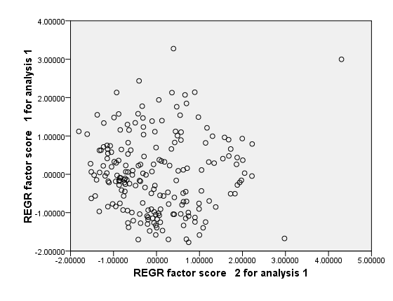
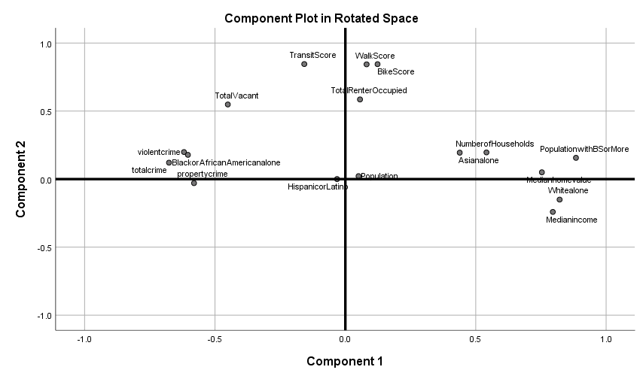
Component Plot Rotated Space:
Graph of each variable plotted over the two principal components.
Hisp/Lat, Pop near the origin( as previously discussed).
Three large groupings of the data. Each fairly independent of one of the components.
Groupings could be more distinct by removing variables outside them, if communality value is low.
Plot of neighborhoods and their corresponding scores for factor 1 and 2. The neighborhoods are fairly spread out in terms of their correlations to factors 1 and 2

Slide 15
Analysis: PCA First Run
After our first run we have constructed two components that are linear combinations of our original variables.
Principal Component 1:
Positively correlated with wealthier, more educated and predominately white neighborhoods.
Negatively associated with dangerous (higher crime rates), emptier (vacant houses
accounted for approximately 47% of the variance. Ideally, we would want this to be higher least 70 – 75%. We can now run PCA again but remove some of the variables first.
Principal Component 2:
Positively correlated with public and non-car transport, more rented households.
No strong negative correlations.
Note: Population and Hispanic/ Latino had very low communality values, so we can remove them and rerun PCA. We can also introduce new data into the set and see how that affects the analysis. From our previous work we will include the variables of the average day to closing 311 calls for the categories: Animals/Pets, Lights / Signals, Mowing / Weeds and Trash / Recycling. We intended to include the calls for City Facilities but there were too few missin entries for each neighborhood. For missing data under the other categories, we inputted the mean value per category.

Slide 16
PCA: Second Run
Communalities
 | Initial | Extraction
total crime | 1.000 | 0.446
violent crime | 1.000 | 0.405
property crime | 1.000 | 0.333
Median income | 1.000 | 0.678
Median home value | 1.000 | 0.587
White alone | 1.000 | 0.696
Black or African American alone | 1.000 | 0.378
Asian alone | 1.000 | 0.210
Total Vacant | 1.000 | 0.467
Total Renter Occupied | 1.000 | 0.276
Number of Households | 1.000 | 0.307
Walk Score | 1.000 | 0.769
Transit Score | 1.000 | 0.769
Bike Score | 1.000 | 0.757
Animals / Pets | 1.000 | 0.068
Lights / Signals | 1.000 | 0.090
Mowing / Weeds | 1.000 | 0.149
Trash / Recycling | 1.000 | 0.280
Population with BS or More | 1.000 | 0.802
The communality values of the variables after removing the variables ‘Population’, ‘Hispanic or Latino’ and adding in the categories ‘Animals / Pets’, ‘Lights / Signals’, ‘Mowing / Weeds’ and ‘Trash / Recycling’.
For future reference let us note that of the new variables ‘Trash / Recycling’ has the highest communality value and the rest are pretty close to zero, so they may not be well fit to be included.
From our original data we also see that the variable ‘Asian alone’ has the next lowest communality value. So if another run is in order these variables are some to keep in mind when making changes to the data. They are not well-explained here.

Slide 17
Second Run: Explained Variance
Total Variance Explained
Component | Initial Eigenvalues |  |  | Extraction Sums of Squared Loadings |  |  | Rotation Sums of Squared Loadings
 | Total | % of Variance | Cumulative % | Total | % of Variance | Cumulative % | Total | % of Variance | Cumulative %
1 | 5.408 | 28.461 | 28.461 | 5.408 | 28.461 | 28.461 | 5.327 | 28.035 | 28.035
2 | 3.059 | 16.103 | 44.563 | 3.059 | 16.103 | 44.563 | 3.140 | 16.528 | 44.563
3 | 2.370 | 12.472 | 57.035
4 | 1.535 | 8.078 | 65.114
5 | 1.071 | 5.638 | 70.752
6 | 0.940 | 4.949 | 75.701
7 | 0.841 | 4.428 | 80.129
8 | 0.803 | 4.228 | 84.357
9 | 0.724 | 3.812 | 88.169
10 | 0.522 | 2.747 | 90.916
11 | 0.440 | 2.314 | 93.231
12 | 0.406 | 2.136 | 95.366
13 | 0.294 | 1.546 | 96.912
14 | 0.198 | 1.041 | 97.952
15 | 0.114 | 0.600 | 98.553
16 | 0.094 | 0.494 | 99.047
17 | 0.091 | 0.478 | 99.524
18 | 0.066 | 0.346 | 99.871
19 | 0.025 | 0.129 | 100.000
For this PCA, we notice that the percent variance of loadings has not increased that much from the last time we ran. So, the changes we made did not increase the amount of information explained by the principal components.
Preferably we want 70% explanation in 3 or less components

Slide 18
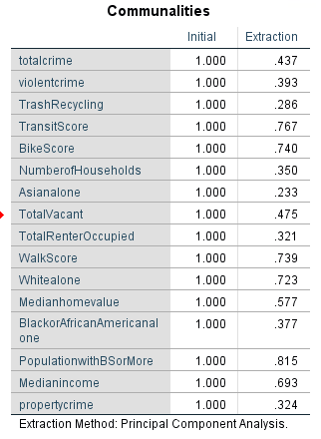
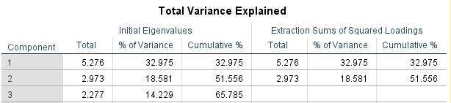
PCA: A Final Run
Taking into consideration fellow group member’s findings – namely the low communality scores for “Hispanic or Latino”, “Lights / Signals”, “Animals / Pets”, etc., a revised reduction was produced.
At this point, the minimum extraction is defined for “Asian alone”, at .233
Per component, this reduction captures more explained variance

Slide 19
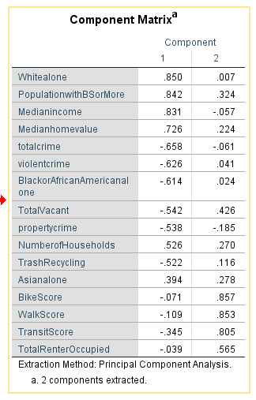
Analysis: PCA Final Run
Like previous iterations,
PC 1 has
A high positive correlation with predominantly white, college-education, higher-earning or more-valued households
Moderately negative correlations with crime and vacancy
PC 2 is
Highly correlated with mobility,
Mildly correlated with renter occupancy
Largely uncorrelated with race and crime

Slide 20
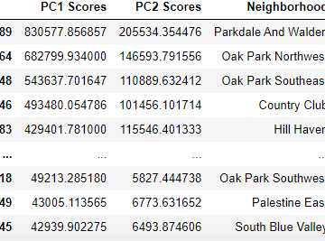
Summary
2 PCs alone may be insufficient to capture enough variance to adequately represent the sample
Reaching above ~70% explained variance may require significant exclusion among variable attributes (columns)
In this instance, PCA’s benefit is limited.
It has, however, allowed us to rank neighborhoods
Best: Parkdale & Walden, Oak Park (NE & SE), Hill Haven, and Country Club
Worst: Leeds, Colonial Square
- PC1 and PC2 scores calculated as simple weighted sums

Slide 21
Appendix
National Center for Educational Statistics. 31 March 2008. http://nces.ed.gov/programs/coe/glossary/s.asp
^
Disability & Socioeconomic Status". American Psychological Association.
3. Practical Guide To Principal Component Methods in R
4. https://builtin.com/data-science/step-step-explanation-principal-component-analysis
https://www.ibm.com/support/knowledgecenter/SSLVMB_23.0.0/spss/tutorials/factoranalysis_table.html

